Slide 1
EXECUTIVE BRIEFING
CLINICAL OPERATIONS &
BUSINESS INTELLIGENCE BRIEF
Presented by Olanrewaju Ibukunoluwa

Slide 2
BUSINESS CONTEXT
Over the past 24 months, leadership at Zion Tech Hub Facility has become increasingly concerned about the hospital's ability to efficiently manage patient flow across the inpatient system.
Despite continued patient activity, several departments have reported challenges in moving patients through the inpatient system. This operational friction compromises service excellence.
KEY CONCERNS UNDER REVIEW:
Operational gridlock within high-volume clinical departments.
Adverse impacts of delayed discharge on overall patient outcomes.
Compounding revenue leakages affecting hospital financial sustainability.

Slide 3
DATA STRUCTURE & ANALYTICAL APPROACH
The analysis integrated approximately 1 million relational records across core clinical operations, finance, demographics, and billing.
RELATIONAL DATA MATRIX
KEY OPERATIONAL METRICS
Unified analytical dataset integrated using:
Inpatient Volume:
Admissions and tracking.
ALOS:
Average Length of Stay.
Total Bed Day Burden:
Ward utilization.
Readmission Rate:
Core clinical quality metric.
Encounter ID
(Encounter activities)
Patient ID
(Demographics & diagnoses)
Payer ID
(Financial transactions & plans)
Data preparation was executed in Excel, analytical querying modeling in PostgreSQL, and final visualization structures built in Tableau.

Slide 4
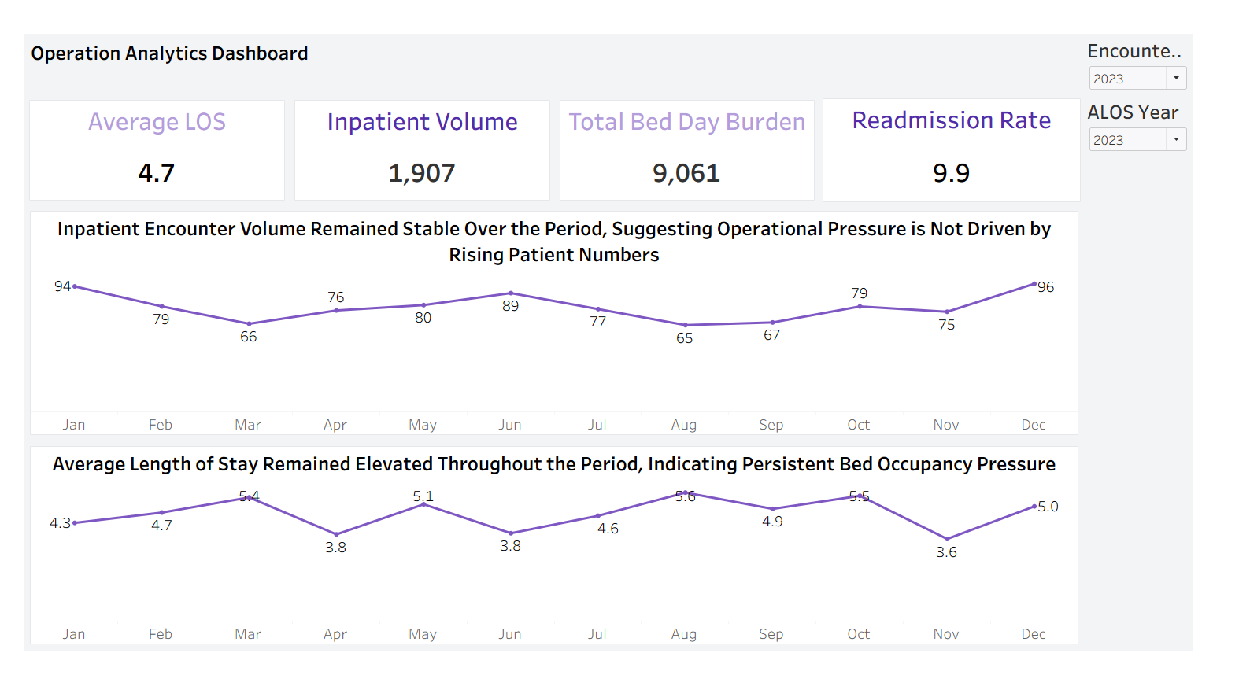

Slide 5
OPERATIONAL DIAGNOSTICS: VOLUME VS. CAPACITY PRESSURES
CORE INSIGHTS & DATA TRENDS:
SEASONAL INPATIENT VOLUME PATTERNS
The top trend line tracks total encounter volume over time, representing the distinct number of individual inpatient admissions and clinical care processes managed by the hospital.
Data shows predictable winter surges, peaking at 94 encounters in January and 96 encounters in December, which perfectly aligns with end-of-year clinical trends.
Outside of seasonal winter surges, baseline inpatient volume is highly stable. This proves operational strain is not driven by an influx of new patient numbers.

Slide 6
OPERATIONAL DIAGNOSTICS: VOLUME VS. CAPACITY PRESSURES
PERSISTENT OCCUPANCY PRESSURE
PROLONGED INPATIENT STAYS
The bottom trend line shows that Average Length of Stay (ALOS) remains elevated year-round, frequently peaking between 5.1 and 5.6 days (March, May, August, October) completely independent of volume dips.
Sustained high ALOS validates concerns regarding delayed patient transition. Because stays remain high during low-volume months, the root cause is isolated to internal operational bottlenecks.
OPERATIONAL IMPLICATIONS:
Workload Bottlenecks:
1,907 total encounters consumed 9,061 bed days, straining ward resources.
Bed Gridlock Risks: High average stays block ward capacity and stall new inbound patient transfers.

Slide 7
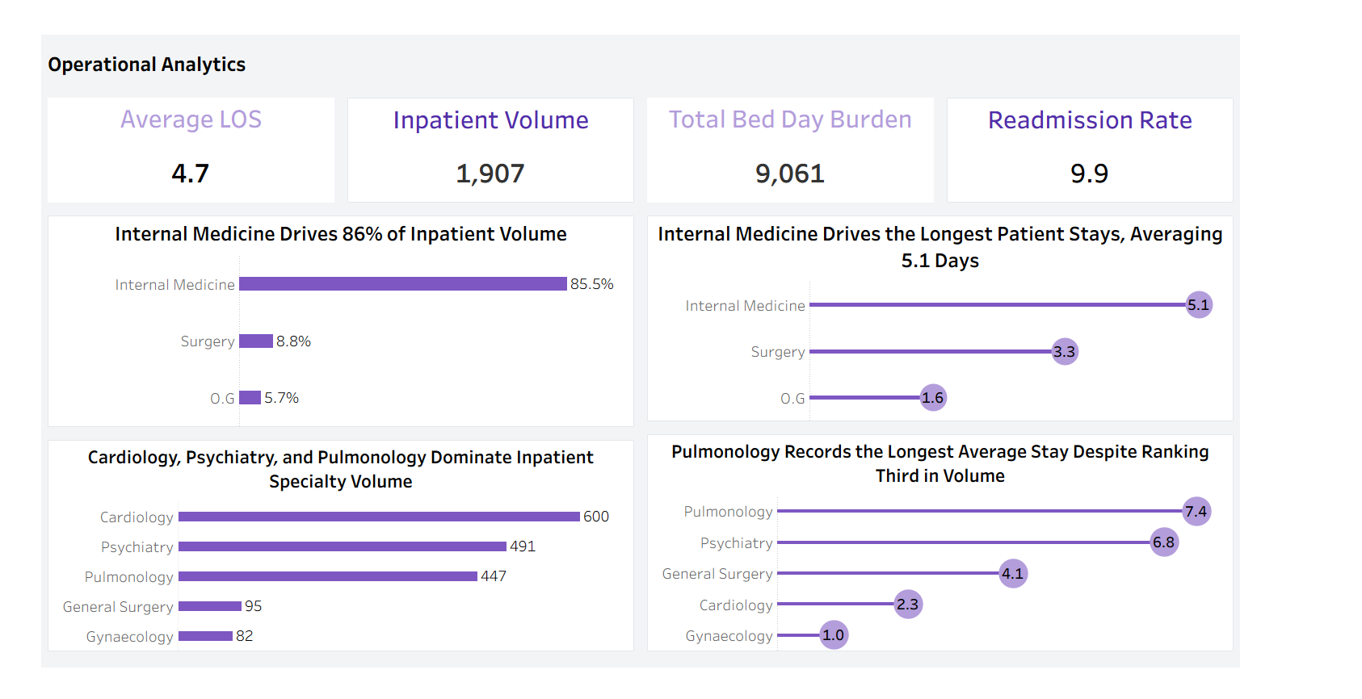

Slide 8
DEPARTMENTAL DIAGNOSTICS: CAPACITY BOTTLENECK
CORE INSIGHTS & DATA TRENDS:
Internal Medicine Dominance: Accounts for 85.5% of total volume and the highest department ALOS of 5.1 days, indicating high centralized pressure.
Specialty Stay Outliers: Pulmonology (ALOS: 7.4 days) and Psychiatry (ALOS: 6.8 days) consume a disproportionate share of bed capacity.
IMPACT ON HOSPITAL OPERATIONS:
Patients in Pulmonology and Psychiatry utilize beds nearly twice as long as other units, creating a severe bed block that directly causes downstream admission bottlenecks.

Slide 9
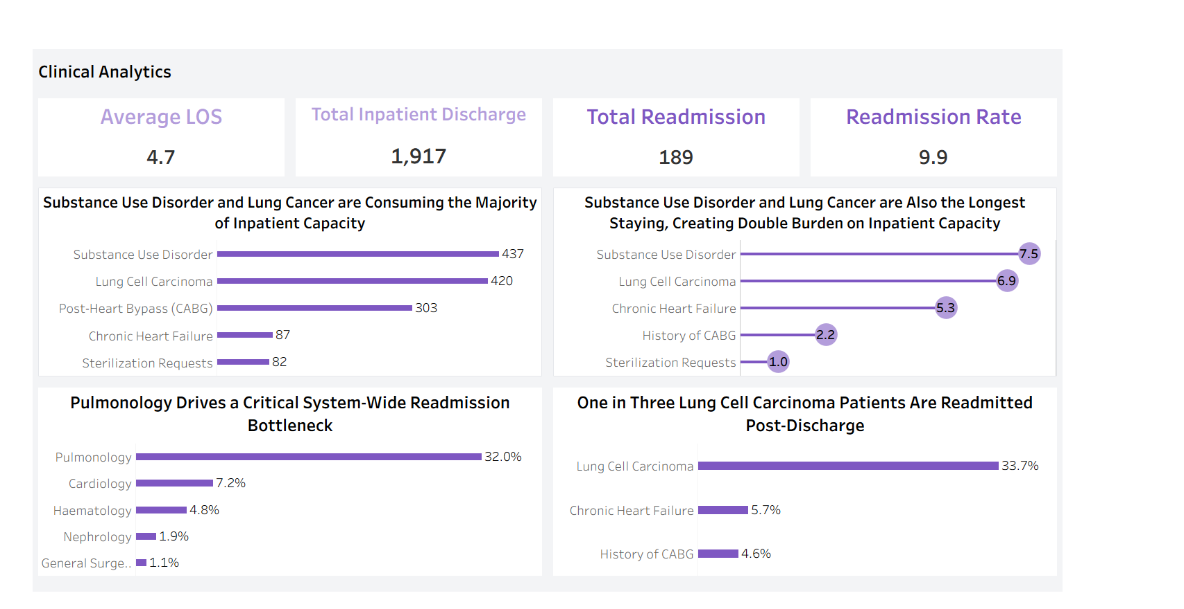

Slide 10
CLINICAL ANALYTICS: DIAGNOSIS & READMISSION DRIVERS
CORE INSIGHTS & DIAGNOSIS DRIVERS:
Substance Use & Lung Cancer: Drills down Psychiatry and Pulmonology's volume. Stays average 7.5 and 6.9 days respectively, creating high capacity demands.
The Readmission Crisis: Pulmonology accounts for 32% of total readmissions. Over 1 in 3 (33.7%) Lung Cancer patients are readmitted post-discharge.
IMPACT ON HOSPITAL OPERATIONS:
While Substance Use causes long initial stays, Lung Cancer creates a repeating cycle of re-hospitalization, severely locking up inpatient beds.

Slide 11
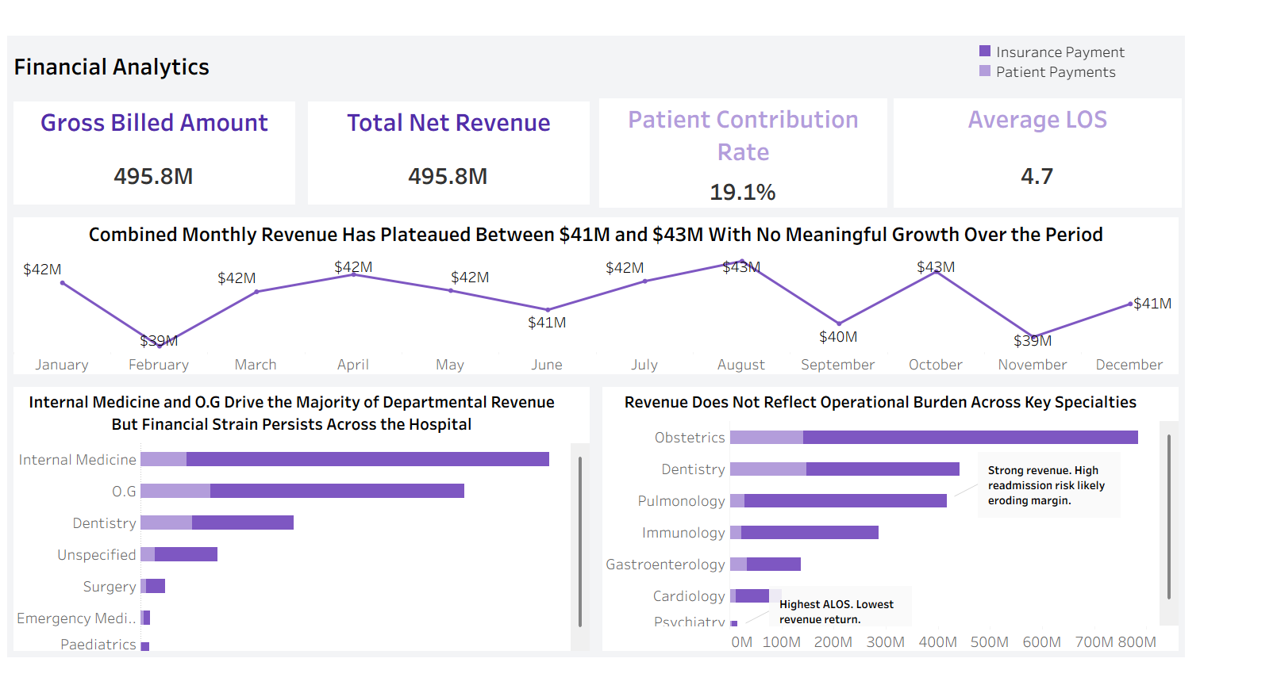

Slide 12
FINANCIAL ANALYTICS: CAPACITY CONSTRAINTS COST
FINANCIAL CONSEQUENCES OF SYSTEM DELAYS:
Stagnant Revenue: Monthly revenues plateaued at $41M-$43M due to fixed capacity ceilings. When beds are full, the hospital cannot admit new patients.
Disproportionate Yields: Psychiatry consumes huge bed day resources but generates the lowest relative yield. Margins are eroded by long stays.
KEY FINANCIAL DIAGNOSTIC:
High-burden clinical specialties with extremely high average stays limit hospital turnaround. Resolving clinical delays directly unlocks new patient admission pathways.

Slide 13
RECOMMENDATIONS: OPERATIONAL LEADERSHIP
IMMEDIATE ACTIONS
FURTHER INVESTIGATION
Establish Step-Down Care Units: Expand step-down clinical capacity to transition stable patients, freeing acute hospital beds.
Audit Inpatient Care Paths: Map the post-discharge care journey to target community medical services and limit readmission.
Deploy Focused Resource Staffing: Increase nursing and operational staff support in Pulmonology and Psychiatry to coordinate timely workflows.
Optimize Dynamic Bed Allocations: Actively match ward bed counts with current seasonal volume demands.

Slide 14
RECOMMENDATIONS: CLINICAL LEADERSHIP
IMMEDIATE ACTIONS
CLINICAL AUDITS
Post-Discharge Care Programs: Prioritize follow-up clinics and community-based telehealth for high-risk Lung Cancer cases.
Discharge Readiness Audit: Audit clinical discharge timelines versus administrative blocks to isolate delays.
Pulmonology Readmission Audit: Target oncology treatment complications causing high readmit loops.
Psychiatric Transition Review: Assess long-stay cases for step-down behavioral placement gaps.

Slide 15
RECOMMENDATIONS: FINANCIAL LEADERSHIP
STRATEGIC RESOURCE ALLOCATION
FINANCIAL QUANTIFICATIONS
Invest in High-Burden Service Lines: Fund clinical transition teams specifically in Pulmonology and Psychiatry to limit avoidable stays.
Determine Margin of Stays: Calculate daily costs of ward occupancy in over-utilized units to establish actual loss margins.
Dynamic Budget Allocation: Adapt department budgets to match actual bed-day demands and capacity requirements.
Quantify Readmission Cost Burden: Map systemic financial penalties of high-readmit patients on current insurance plans.

Slide 16
DATA LIMITATIONS & SCOPE CONSTRAINTS
ABSENCE OF DIRECT COST AND MARGIN METRICS
The dataset lists Gross Billed Amount and Net Revenue, but lacks internal operational cost accounting metrics. We cannot calculate exact margins or financial loss per extended stay.
LACK OF CLINICAL SEVERITY & ACUITY DATA
No clinical acuity tracking scores exist in the database. We cannot definitively say if a 7.5-day stay is driven by workflow delays or necessary clinical stabilization.
NO POST-DISCHARGE PATIENT TRACKING
Outpatient medication adherence and clinical follow-ups are untracked. The root causes of the 33.7% Pulmonology readmissions cannot be definitively mapped to external gaps.

